Slide 1

Name: Class: | ____________________________________ ________________ | Date:_________
 | Year 7 Mathematics 2019 Investigation #1 Area and Perimeter Resources Allowed: Personal notebook/ calculator Time allowed: 20mins for part A and 35mins for part B Part A : Collaborative Component (not marked)
For the first part of our assessment, we work through the questions together.
There are no marks for this part, but it will show you how to do the rest of the investigation

Slide 2
Three Farmers need to make a paddock for their sheep. Farmer Jill makes a square paddock that is 50m x 50m. Farmer Steph makes a paddock that is 65m x 35m and Farmer Adam makes a paddock that is 80m x 20m.
a) Add these dimensions to the diagrams below.
Steph’s Paddock
Jill’s Paddock
Adam’s Paddock
b) Use your knowledge of perimeter to work out the amount of fence required for each paddock.
c)Now use the area formula below to calculate the area inside each paddock and complete the table on the next page.
Area of a rectangle = length x width

Slide 3
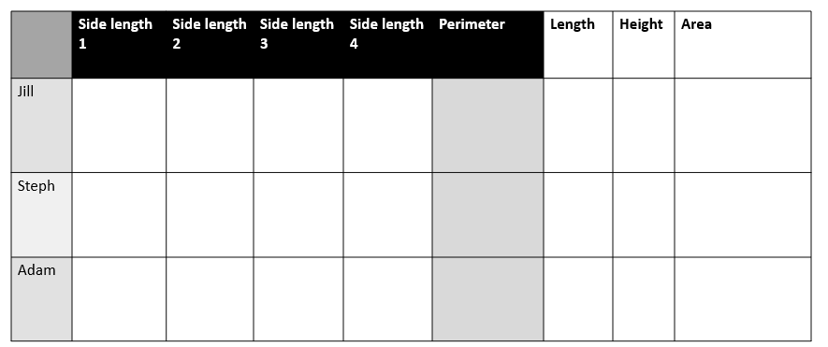
Looking at the paddock with the largest area, what do you notice about the length of the sides?

Slide 4
Name: Class: | ____________________________________ ________________ | Date:_________
 | Year 7 Mathematics 2019 Investigation #1 Area and Perimeter Resources Allowed: Personal notebook/ calculator Time allowed: 35mins Part B : Individual Component
/6
For the second part of our assessment, you need to complete this on your own.
There are 6 marks for this part, and we will mark it before we give you the validation.

Slide 5
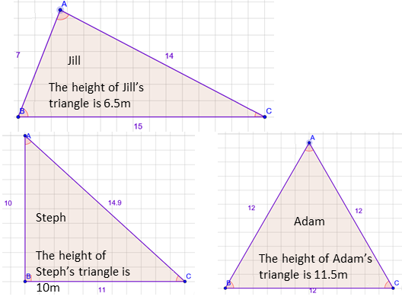
Question 1.
Farmer Jill, Farmer Steph and Farmer Adam needed to build a small enclosure for chickens. Each farmer used the same amount of fencing.
15
How much fence did they each use?
b) How did you work this out? Show all 3 calculations
c) Mathematically What is the term we use for “the distance around the shape”?

Slide 6
Question2.
The three farmers all thought their enclosures were the biggest. Use the area of a triangle formula to work out which farmer is right.
Area of a triangle = base x height ÷ 2
a) What is the area of Jill’s enclosure?
b) What is the area of Steph’s enclosure?
c) What is the area of Adam’s enclosure?
d) Use the information you have calculated so far to complete the table below.
 | Side length 1 | Side length 2 | Side length 3 | Perimeter | Base Length | Height | Area
Jill
Steph
Adam
e) Looking at the triangle that has the biggest area, what do you notice about the lengths of the sides compare to the other 2?

Slide 7
Name: Class: | ____________________________________ ________________ | Date:_________
 | Year 7 Mathematics 2019 Investigation #1 Area and Perimeter Resources Allowed: Personal notebook/ calculator Time allowed: 35mins Part B : Individual Component
/6
Answers

Slide 8
Question 1.
Farmer Jill, Farmer Steph and Farmer Adam needed to build a small enclosure for chickens. Each farmer used the same amount of fencing.
15
How much fence did they each use?
36m
b) How did you work this out? Show all 3 calculations
7+14+15 = 36m 10+15+11 = 36m 12+12+12 = 36m
c) Mathematically What is the term we use for “the distance around the shape”?
The perimeter

Slide 9
Question2.
The three farmers all thought their enclosures were the biggest. Use the area of a triangle formula to work out which farmer is right.
Area of a triangle = base x height ÷ 2
a) What is the area of Jill’s enclosure? 6.5x15÷2 = 48.75m²
b) What is the area of Steph’s enclosure? 10x11÷2 = 55m²
c) What is the area of Adam’s enclosure? 11.5x12÷2 = 69m²
d) Use the information you have calculated so far to complete the table below.
 | Side length 1 | Side length 2 | Side length 3 | Perimeter | Base Length | Height | Area
Jill | 7 | 14 | 15 | 36m | 15 | 6.5 | 48.75m²
Steph | 10 | 10 | 15 | 36m | 11 | 10 | 55m²
Adam | 12 | 12 | 12 | 36m | 12 | 11.5 | 69m²
e) Looking at the triangle that has the biggest area, what do you notice about the lengths of the sides compare to the other 2? When triangles have the same perimeter, the closer the sides are to beging equal, the larger the area.

